Slide 1



DESKTOP (AI) ASSISTANT
SLP - PROJECT

Slide 2


WHAT IS AI ?
AI stands for Artificial Intelligence. It refers to the simulation of human intelligence in machines that are programmed to think and learn like humans. It includes a wide range of technologies and techniques, such as machine learning, natural language processing, and robotics. The goal of AI is to create systems that can perform tasks that typically require human intelligence, such as recognizing speech, understanding natural language, and making decisions

Slide 3
TABLE OF CONTENTS
01
02
03
04
05
INFORMATION ABOUT USED A MODULE
ABOUT THE PROJECT
A REAL GRAPHICAL USER INTERFACE(GUI)
MAIN FEATURES
LIMITATIONS OF OUR PROJECT

Slide 4

01
INFORMATION ABOUT USED A MODULE
There is some basic terminologies !!!

Slide 5
USED MODULE-1
speech_recognition:
This module is used for performing speech recognition, i.e. transcribing spoken audio into text. It provides a simple and consistent interface for various speech recognition engines and APIs, including Google Speech Recognition, Sphinx, and others.
datetime:
This module provides various classes for manipulating dates and times, including the datetime class for working with date and time objects, the timedelta class for working with time durations, and the tzinfo class for working with time zones.
time:
This module provides various functions for working with time, including the sleep() function, which can be used to pause the execution of a program for a specified number of seconds.
os:
This module provides a portable way of using operating system dependent functionality such as reading or writing to files, starting new processes, killing processes etc.

Slide 6
USED MODULE-2
dotenv:
This module allows to load environment variables from a .env file. It is commonly used to store sensitive information like API keys, secrets, and passwords.
pywhatkit:
This module allows you to send scheduled WhatsApp messages, play songs on YouTube at a specific time, search information on Google, and more.
playsound:
This module allows to play sound files on different platforms. It provides a simple and consistent interface for playing sound files on Windows, Mac, and Linux.
selenium:
This module is widely used for automating web browsers. It allows to automate web browsers and perform tasks such as web scraping, testing, and automating form submissions.
googletrans:
This module provides a simple and powerful API to translate text from one language to another.

Slide 7
02
ABOUT THE PROJECT
Let’s get started !!!

Slide 8
HOW IT’S WORK
SPEECH-TO-TEXT
PROCESSING
LEARN FROM DATA
Our AI system is designed to learn from its previous data, which means that it can improve its performance over time.
The system starts by capturing the spoken command through a microphone and then converts the audio into a text. It’s called natural language processing(NLP)
Once the meaning of the text is understood, the system can perform a variety of actions, such as answering questions, providing recommendations, or performing a specific task.

Slide 9
HOW DOES A I LISTEN
This code is using the speech recognition (sr) module to take input from a microphone. The function, called "takeinput()", uses the Recognizer class from the sr module to listen for audio input from a microphone.
The function initializes an instance of the recognizer and opens the microphone as the audio source. It then listens for audio input for up to 8 seconds and assigns it to the "audio" variable.
Then it prints "Listening..." and sets a pause threshold of 1 second.
It then listens to the microphone input for 8 seconds and attempts to recognize it using the recognize_google() method with Hindi language as an argument. If it is unable to recognize the input, it returns "None". Lastly, it converts the recognized query to lowercase and returns it as a string.

Slide 10
AI BRAIN
This function is designed to act as the "brain" of an AI system. It is important because it allows the AI to learn from previous data and improve its responses. The function takes in a "question" and "chat_log" parameter, with the "question" representing the input the AI is receiving and the "chat_log" representing the previous conversations the AI has had.
The function first reads in the previous conversations stored in the "chat_log.txt" file and assigns it to the "chat_log_template" variable. It then uses the OpenAI API to generate a response to the "question" by creating a "prompt" string that includes the "chat_log" and "question" and passing that to the API. The API returns a "response" object, which the function then extracts the top choice of answer from and assigns it to the "answer" variable.
The function then updates the "chat_log_template" with the new "question" and "answer" and writes it back to the "chat_log.txt" file, thus allowing the AI to learn from previous data. The function finally returns the "answer" variable as the result. This way the AI is able to learn from previous conversations and improve it's responses over time, thus making it more intelligent.
.

Slide 11
SPEAK FUNCTION
This function utilizes the Selenium webdriver module to navigate to a text-to-speech website, https://ttsmp3.com/text-to-speech/British%20English/ and converts the input text into an audio file. It first checks if the input text is empty or not, if it is empty the function will do nothing and pass. If the text is not empty, it will print the text preceded by "AI" on a new line.
The text is then sent to the text field on the website using Selenium webdriver, simulating a button press to initiate the text-to-speech functionality. The function then clears the text field and based on the length of the text it will wait for 5 seconds if the text is less than 8 characters, and if the text is greater it will stop the execution. The overall purpose of the function is to convert text into an audio file for the AI to "speak".

Slide 12
03
A REAL GRAPHICAL USER INTERFACE(GUI)
Let’s create GUI using flask !!

Slide 13
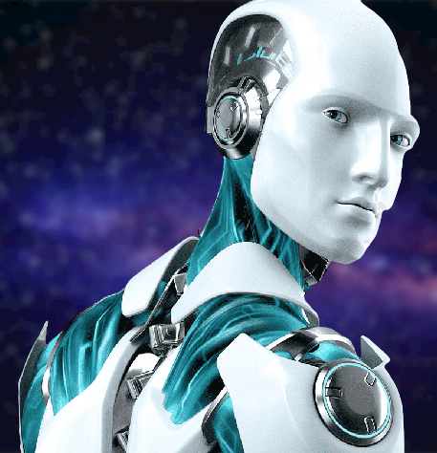
AWESOME GUI USING FLASK
we built our awesome GUI using Flask by defining a class for my application and using it to organize my views and other functionality. Flask provided a simple and easy-to-use interface for creating the web-based GUI for my AI project.

Slide 14
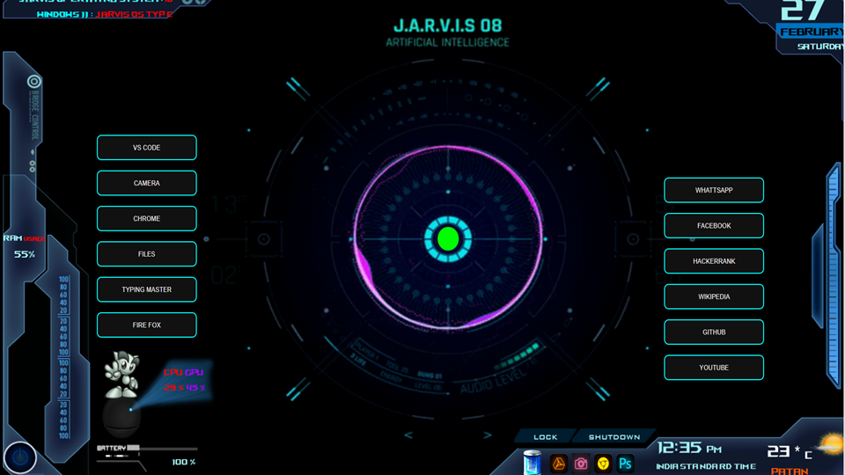
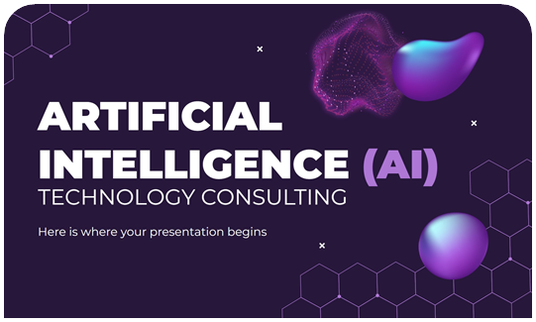
GUI preview
It have shortcuts button to open some applications and to get some website directly

Slide 15


GUI PREVIEW

Slide 16
04
MAIN FEATURES.
Let’s see what AI Can do !!

Slide 17
01 PLAY YOUR FAVORITE SONG
One of the best things about our ai is its ability to play your favorite song by simply requesting it’s name. This is an awesome feature that makes it easy to listen to your favorite music without having to search for it manually.

Slide 18
02 APPLICATION LAUNCHING
Our AI is capable of opening applications on your computer or laptop with ease. Simply provide the name of the desired application and our AI will quickly launch it for you. This feature is particularly useful for those who frequently use multiple applications and want to save time by avoiding the need to manually navigate to the application and open it. With our AI, you can launch your favorite applications with just a simple command, making your work flow more efficient and streamlined.

Slide 19
03 LISTENING AND ANSWERING QUESTIONS
Our AI is capable of listening to your questions and answering them using previous data. This advanced feature allows for efficient and accurate responses, making it a valuable tool for a variety of tasks. Whether you need information on a specific topic or help with a problem, our AI can assist you with quick and relevant answers. It is able to understand natural language and can provide helpful responses in a conversational manner. This makes it easy to use and navigate, saving you time and effort. The AI's ability to access previous data also means it can learn and improve over time, providing even more accurate responses in the future."

Slide 20
04 STORE CONVERSATION IN DATABASE
Our AI is capable of not only answering your questions, but also keeping a record of the entire conversation. With the new chat log feature, you can easily access and review previous conversations with the AI. The chat logs are stored in a simple .TXT file format, making it easy to access and read. This feature is particularly useful for businesses and organizations, as it allows them to keep track of customer interactions and improve their services. It also allows users to refer back to previous conversations for any information they may have missed. With this new feature, our AI is not only able to provide intelligent answers, but also to keep a record of the conversation for future reference.

Slide 21
05
LIMITATIONS OF OUR PROJECT.
Exploring the limitations of our project

Slide 22
01 HIGH VOLUME INTERFERENCE
While our AI is capable of playing your favorite songs on command, it is important to note that high intensity volume levels can interfere with the conversation between the AI and the user. This is a limitation of the technology, and it is important to consider this when interacting with the AI

Slide 23
02 POSSIBILITY TO PRODUCE INCORRECT ANSWER
"Our AI is a powerful tool that is capable of providing insightful responses to a wide range of questions. However, it's important to note that like any technology, our AI also has some limitations. One of the most notable limitations is the possibility of producing incorrect answers. This may occur when the AI is not able to understand the user's question or if the question is too complex for the AI to provide an accurate response. It's important to keep in mind that while our AI is a valuable resource, it should not be the only source of information when seeking answers. It's always a good idea to cross-reference any information provided by the AI with other credible sources

Slide 24
03 POSSIBILITY OF NEW BUGS
One potential limitation of our AI is the presence of new bugs. These bugs can manifest in a variety of ways, such as errors in the output or unexpected behavior. While our team works hard to identify and fix these bugs as soon as possible, they may still occur and may impact the performance of our AI. We apologize for any inconvenience this may cause and strive to continue improving the technology to minimize the occurrence of bugs.

Slide 25

TEAM
SHAILESH
ER.NO : 216310307026
CLASS : A-2
MEET
E.R.NO : 216310307027
CLASS : A-2
PRINS
ER.NO : 216310307007
CLASS : A-1

Slide 26
THANKS!
DO YOU HAVE ANY QUESTIONS?
prajapatishailesh4941@gmail.com
prajapatishailesh4941@gmail.com
prajapatishailesh4941@gmail.com

